Slide 1
Under Wraps: Packaging Materials, Their History, Their Efficacy and Creating Packaging Material Inspection Protocols
877.718.6868 | pure-processing.com

Slide 2
In this session:
Shawn Engberg provides:
history and evolution of sterile packaging materials
studies regarding surgical site infections and compromised wrap materials
central sterile’s important role in successful sterilization of sterile packaging materials

Slide 3
Under Wraps: Objective
provide protocols for creating departmental checklists based on standards and guidelines
help ensure sterile packaging material integrity
Help ensure patient and staff safety

Slide 4
Shawn Engberg
Operating room facilitator
Neuro and orthopedic surgery coordinator
Sterile processing manager
Volunteer for AAMI’s Standard Committee for Sterile Processing
Member of IAHCSMM
Advantage Support Services
20 years of service in the operating room and sterile processing department

Slide 5
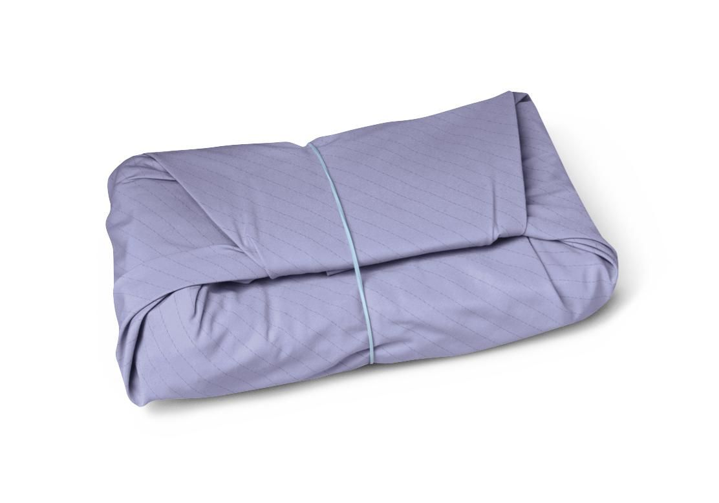
History of Sterile Packaging Wrap
Original sterilization wraps
140-thread count muslin cloth
Advantages
Soft
Reusable
Inexpensive
Drapeable

Slide 6
History of Sterile Packaging Wrap
140 Count Muslin Cloth
Disadvantages
did not provide complete protection against microbial penetration
Material was derived from cellulose and did not possess adequate strength
Result of lack of protection against microbial penetration
hospitals initiated double sequential wrapping

Slide 7
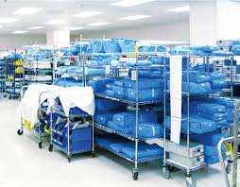
History of Sterile Packaging Wrap
Introduction of non-woven wrap allowed the development of wraps that possessed:
Strength
Barrier
Repellant properties

Slide 8
History of Sterile Packaging Wrap
Disadvantages of non-woven wrap:
Single-layer
Easily punctured
Costs increased
Result of lack of protection against microbial penetration
hospitals initiated double sequential wrapping

Slide 9
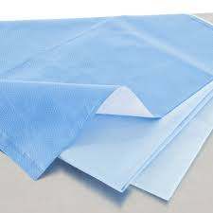
History of Sterile Packaging Wrap
Introduction of spunbound-meltblown-spunbond 3-layer bonded wrap:
Ultimate strength
Less punctures

Slide 10
History of Sterile Packaging Wrap
Disadvantages:
Still developed holes

Slide 11
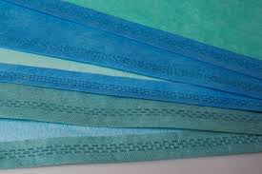
History of Sterile Packaging Wrap
Manufacturer’s developed thermal bonded layers with multiple colors.
Allowed for technicians to more easily spot holes

Slide 12
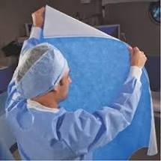
History of Sterile Packaging Wrap
Under 2cm holes, still remained difficult to detect holes with the naked eye.
Disadvantages
Unknown contamination of pans
Not 100% effective
Costly

Slide 13
First Defense
Sterile Processing
Technicians are on the frontline defending pathogens
Patient safety

Slide 14
Goal: No Light
No holes = no light coming through sterile wrap
No holes = contamination proof
No holes = patient safety

Slide 15
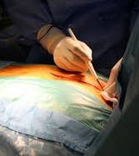
Surgical Site Infections
Account for 20% of all HAIs
Most common and costly of HAIs
Occur in an estimated 2% to 5% of patients undergoing inpatient surgery
Est. annual incidence of SSIs in the U.S.: 160,000 to 300,000

Slide 16
Surgical Site Infections
Est. annual cost ranges from $3.5 billion to $10 billion
Results in non-payment of initial procedure and subsequent procedures

Slide 17
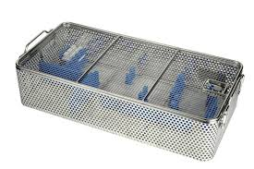
Orthopedic Pan Wrap Scenario
Wrapping orthopedic pans is a multi-step process
Orthopedic pan sizes present wrap challenges

Slide 18
Surgical Site Infections
SSI increases the hospital length of stay by 9.7 days
Patient’s skin is the direct source of contamination in only 2% of cases
98% of cases related to airborne particles

Slide 19
Costs of Compromised Wrap
Delaying surgical procedure: $125-150 per minute
Patient under anesthesia longer
Extra sterilization procedures and materials
Cost of pan: $150

Slide 20
Clinical Orthopedics & Related Research Study
Study
Looking for Holes in Sterile Wrapping: How Accurate Are We?

Slide 21
Study Results
Success rate of correctly identifying sterile wrap defects

Slide 22
Sterile Processing’s Role in Inspection of Packaging Materials
Infection Prevention
Prevention of cross contamination
Quality assurance
Standards and Guidelines
Improve Efficiency
Improve waste – re-sterilization
Cost reductions

Slide 23
Training Goals for Sterile Processing Technicians
Look for holes at the onset of wrapping pans
Raise accuracy of hole detection 51% up to 90%
33% of every SSI is a result of orthopedic cases
Proper sterile wrap selection

Slide 24
Training Goals for Sterile Processing Technicians
Train scrub and OR techs to detect wraps in the OR as well
Make sure all technicians are on the same page

Slide 25
Study takeaways
Anything below 2cm, does not have an accurate read on detecting holes in sterile wrap
Under Wraps
Create system to detect holes and imperfections in sterile wrap
More training
Better handling of pans and materials

Slide 26
Cost Savings
Without proper detection of holes, cost savings is non-existent
Impact of re-sterilizing pans is $150 on average
OR cost: $125-150 per min (17-20 min. to re-sterilize a pan)
SSI costs

Slide 27
Creating sterile wrap protocols to:
Improve patient safety
Improve staff safety
Reduce package compromises
Implement cost-savings
Improve integrity of the material and the instruments being sterilized

Slide 28
Three Objectives for Successful Packaging
Allow penetration of the chosen sterilant and compatibility with other requirements of sterilization process
Maintain the sterility of the package contents until the package is opened
Create a package that can opened aseptically

Slide 29
Sterilization Packaging = FDA Class II medical device
presents a potential risk to the patient
consequences of using a non-sterile item during a surgical procedure can be life-threatening.
Critical to choose steam sterilization packaging that is capable of withstanding temperatures of 250*F to 275*F

Slide 30
When selection packaging materials, request samples from manufacturers
By requesting samples, healthcare facilities can make sure materials:
meets the needs of the facility
“allows the sterilizing agent to penetrate and reach all surface areas of the items to be sterilized.”
“maintain sterility of the item up until its use, performing as a reliable barrier to microorganisms.

Slide 31
Checklist for choosing wrap material:
Package can be opened in aseptic manner
Material conforms to the size and shape of the items
Covers contents in their entirety
Provides for maximum amount of use
Allows air to be completely removed during the sterilization process

Slide 32
Checklist for choosing wrap material:
Withstands physical conditions produced by the autoclave, including, moisture, pressure and high temperatures
Permeable to the sterilizing agent and moisture
Allows escape and removal of the sterilizing agent at the end of the sterilization process

Slide 33
Checklist for choosing wrap material:
Allows contents to be dried after sterilization with no presence of moisture
Allows ethylene oxide gas and moisture to escape during the aeration cycle
Resists tears and punctures during sterilization and normal handling
Does not easily degrade when the sterile packages are stored

Slide 34
Checklist for choosing wrap material:
Provides a barrier to the penetration of dust and particles and resists moisture penetration
Free of lint and free of loose fibers
Free of any toxic material or dyes that could produce a chemical reaction during the sterilization process
Free of bleaches and detergents that could produce a chemical reaction during the sterilization process

Slide 35
Checklist for choosing wrap material:
Promotes the integrity of the seal that is used to secure items so that content sterility is maintained
Incapable of being re-sealed, once the seal is broken or package is opened
Cost-effective for the facility

Slide 36
Woven Packaging Materials
Available in:
140 thread count muslin which is a cotton, calico and barrier type cloth
made of 100% unbleached loosely-woven cotten fibers and made of two-ply fabric fastened together as one wrap
Other woven fabrics in sterilization are:
Duck cloth
Twill
Treated barrier fabrics

Slide 37
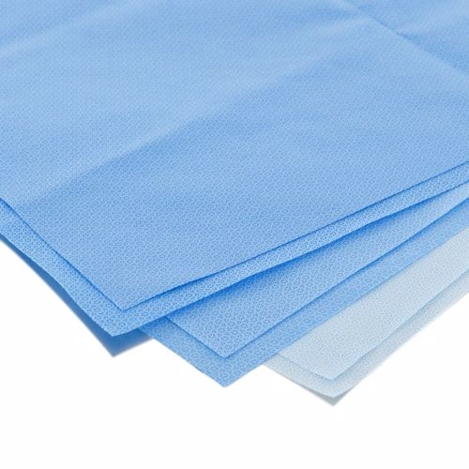
Disposable packaging materials
Paper
Polyolefin plastic
Disposable nonwoven wraps.

Slide 38
Kraft-type papers
available in various sizes
porous or soft-good items
available in medical-grade pouches to hold small parts and instrument
available as flat wraps

Slide 39
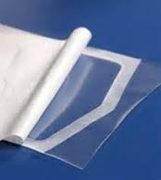
Paper/plastic and spunbond polyolefin-plastic combinations
commonly used and often referred to as peel pouches

Slide 40
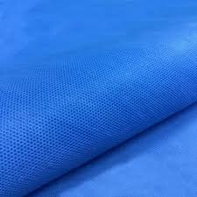
Spunbound-meltblown-spunbond flat wraps
constructed by polyolefin layers exposed to high heat
pressure-bonded together to form sheets
designed as single-use disposable products
come in a variety of sizes and as single - or double-sheet wraps that are bonded together

Slide 41
Request Manufacturer’s Information
Request and review the manufacturer’s information to:
ensure it is appropriate for the method of sterilization to be used
to review and maintain a written copy of the sterilization validation studies

Slide 42
Reusable Packaging Materials
When using reusable packaging materials:
materials should be laundered
inspected and properly stored between every use
Single-use packaging materials should be:
properly stored to preserve the packaging properties of the material

Slide 43
Woven Packaging Recommendations
De-linted prior to use
Inspected for holes, tears, and thinning of the material each time after laundering
Defects should not be sewn
Have a tracking system in place to track the number of times a woven product is laundered and sterilized
Check manufacturer recommendations for the number of times product can be processed and used

Slide 44
Preparing Packaging
Use correct size wrapper in order to ensure complete coverage of the contents
Wrapper should not be too large in order to prevent air pockets from forming
Wrappers should be large enough to extend a minimum of six inches below the four sides of the table or basin ring
Wrappers must be large enough to cover the hand of the individual opening it

Slide 45
Preparing Packaging
Before wrapping an instrument tray, an absorbent lint-free linen towel should be placed between the bottom of the tray and wrapper to cushion the corners of the tray and prevent tearing
Limit density of packaged items
AAMI has recommended that instrument sets should not exceed 25 pounds.

Slide 46
Preparing Packaging
FDA cleared as medical sterilization packaging systems for use in health care facilities
stored and maintained according to the manufacturer's written IFU
selected according to the size, shape, and weight of the medical device to be processed
wrapped securely to prevent gaps in the wrap material
not wrapped too tightly because tears and punctures could occur

Slide 47
When choosing non-woven wraps:
choose the grade of sterilization wrap according to the size, shape and weight of the medical devices to be wrapped, facility guidelines and wrap manufacturer’s IFU
inspect the wrap to ensure that it is free of defects
confirm that the wrap is free of nonfast dyes
designed to minimize the generation and shedding of fibers or particulates/(lint) during normal use
check manufacturer expiration dates prior to use

Slide 48
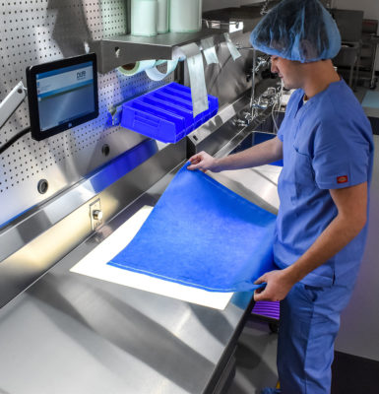
Inspection of wraps
Recommended by IAHCSMM to ensure that:
“there are no tears, punctures, worn spots or stains from previous use.”
“Inspection is performed using a light table that has a light source built into the tabletop to help spot small holes and punctures. As the wrap is passed over the lighted tabletop, light shines through the small holes and punctures making them easier to identify.”

Slide 49
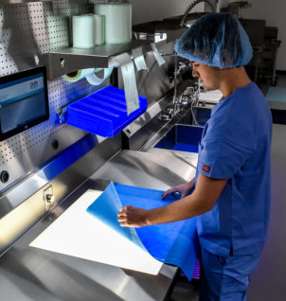
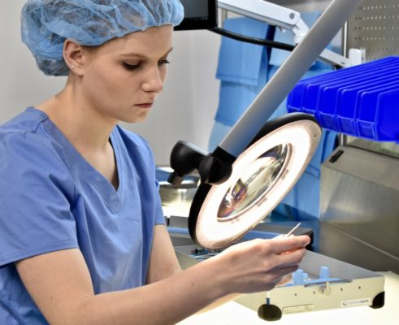
Use of lighting in inspection of materials
IAHCSMM recommends
proper lighting in the assembly area as the work being performed is very detailed and inadequate lighting can lead to errors and strain.
Table top lighting & magnifying task lights promote:
ergonomic ease on central sterile technician
Limits eye and physical strain
productivity and quality assurance

Slide 50
Conclusion
Selection of proper sterilization packaging materials:
patient safety in improved
staff safety is improved
package compromises reduced
cost-savings are implemented
integrity of the material and the instruments being sterilized is improved

Slide 51
Sources
IAHCSMM Central Service Technical Manual, 8th Edition https://www.iahcsmm.org/publications/central-service-technical-training-8.html
ANSI/AAMI ST79: 2017 Comprehensive Guide to Steam Sterilization and Sterility Assurance in Health Care Facilities https://www.iahcsmm.org/publications/ansi-aami-st79.html
AST Standards of Practice for Packaging Material and Preparing Items for Sterilization https://www.ast.org/uploadedFiles/Main_Site/Content/About_Us/Standard_Packaging_Materials_Preparing_Items.pdf

Slide 52
Sources
Orthopedic Clinic & Research Related https://www.ncbi.nlm.nih.gov/pubmed/29432266
Preventing Surgical-site Infections: Measures Other Than Antibiotics https://www.sciencedirect.com/science/article/pii/S1877056814003272

Slide 53
pure-processing.com
877.718.6868

