Slide 1

Finding your Happy Medium:
4 Common Stressors to Address Before Electives Resume
877.718.6868 | pure-processing.com
Notes:
Good afternoon everyone, and thank you for joining me today for our informational presentation.
My name is Megan Pietura, I’m the operations manager at Pure pProcessing, and I work directly with departments like yours day 2 day to improve efficiencies, workflows, and improve ergonomics in central departments.
Decided to call this presentation Finding Your Happy Medium because we probably fall somewhere halfway through this pandemic. We’re hearing news of electives return, but the hammer hasn’t come down completely yet… our new normal!
Based on some customer feedback, I’ll go over 4 areas where efficiency might feel stressed during normal conditions, so you might want to consider in your own department, do you feel stressed in these areas?

Slide 2
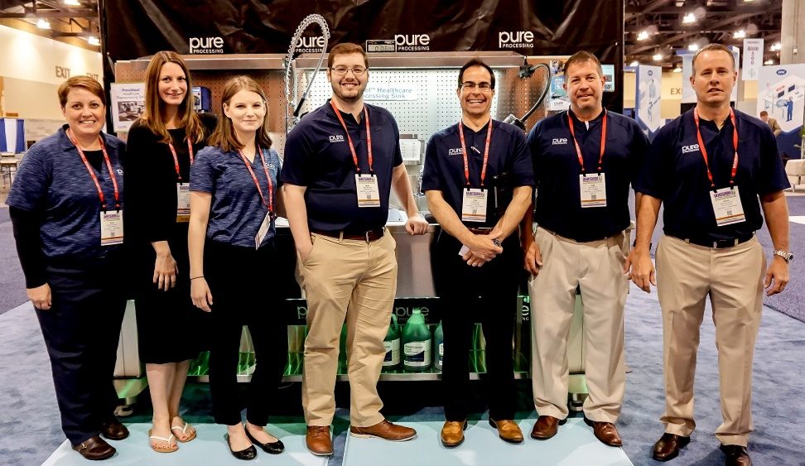
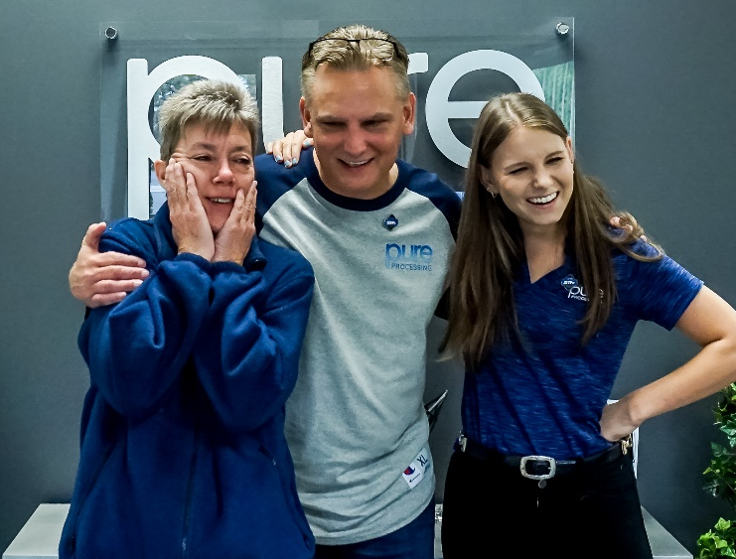
Who is Pure Processing?
Pure Processing develops and manufactures ergonomic solutions for easy, fast, safe and effective medical device pre-cleaning. We help surgical, diagnostic, endoscopy and reprocessing departments protect their most important assets: their staff and their medical device inventory.
Notes:
For those of you who don’t know Pure Processing, we got our start in the decontamination side of the department about 10 years ago, this year was going to be our 10th anniversary in Chicago, so happy to spend it with you right here right now!
Our focus has always been, how do we make instrument reprocessing more efficient, easier, and safer for you and your team. From literal and workflow pinch points, we try and iron out the process and make it smoother.

Slide 3
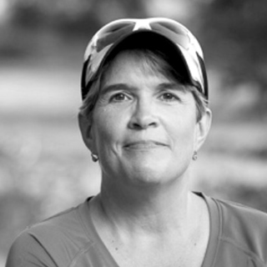
Rhonda Foulds
Started experiencing first symptoms of Parkinson’s at 35
Sought help through DBS surgery; got MRSA from infected battery pack
By 2020, completed her 100th marathon
“Living well for Rhonda means allowing Parkinson’s only to be a back-seat passenger in her life instead of a front seat driver. Rhonda is a person who is the sum of all her parts, and she refuses to let Parkinson’s take over.”
Notes:
Before we start I want to quickly share a story about Rhonda Foulds, a colleague of my coworker here at Pure Processing, and I felt it was really relevant to today. Rhonda was diagnosed in 1998 with Parkinson’s at 35. Probably felt like a bomb, so much chaos, confusion, -
Rhonda eventually sought help through deep brain stimulation surgery, only to come out of surgery with MRSA because her battery pack got infected.
While the DBS surgery was life changing, MRSA recovery only made her personal marathon harder.
Rhonda returned to running, to help with her Parkinson’s symptoms, and just this year completed her 100th marathon.
I like this quote by Rhonda here – this situation her Parkinson’s, it has to take a backseat, like the pandemic. It drives what we do, but not how effective we can be. We use this opportunity to drive change.

Slide 4
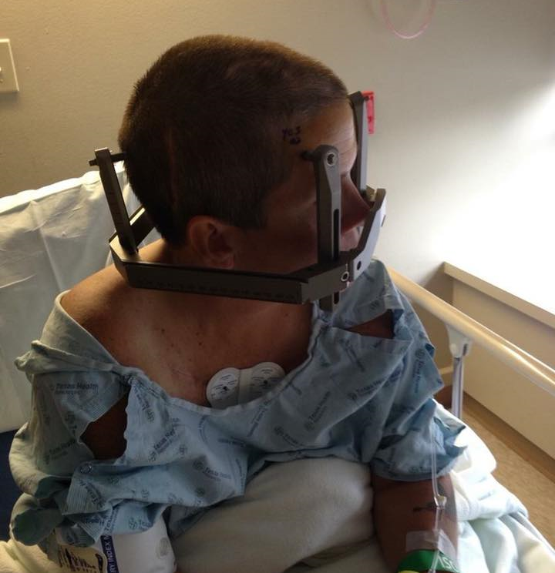

“What’s your marathon?”
Notes:
So I ask, we all feel like we’re in a bit of a marathon right now; hard to see how much farther we have left to run, but we know we need to keep running.
Quarantines, loss of electives, these things make us feel like we’re experiencing personal & professional setbacks. But we’re all running a marathon right now, but how do we use this situation as a motivator for good? We look to Rhonda as one example.

Slide 5
Meditation is:
Conscious thinking about something, which should:
(1) Create Awareness
(2) Clarify the Chaos
(3) Simplify the Path Forward
Notes:
One way through this chaotic environment is meditation.
Meditation goes by many definitions, but at its’ root, it’s thinking deeply on something. Conscious thinking. That conscientious effort should help: (1) create awareness, (2) clarify the day-2-day chaos, and (3) simplify/clarify the path forward.
Rhonda used a moment of personal meditation to figure out what needs to happen: I need to start running again. I need to get connected back to my needs, my goals… we’re all at a point where a little mediation session can help do these three things, and analyze our department workflows.

Slide 6
Meditation Insights
Based on customer “meditation” sessions and feedback, we identified 4 common stressors that they would address before electives return:
Inspection
Soaking
Flushing
Ergonomics
Notes:
With good meditation comes good insight. Based on some “meditation” sessions we’ve had with customers, we’ve come to 4 main places where instrument reprocessing gets bottlenecked, or where its efficiency can be dampened in instrument reprocessing.
These 4 areas: inspection, soaking, flushing, and ergonomics, can be improved during some department’s downtime without normal surgery volumes. When surgeries resume, you can feel more in control of these areas, or know you’ve opened up these bottlenecks.

Slide 7
Stressor: Inspection Procedures
Meditation Insights:
  (1) I should have a process in place to inspect wrap for tears/punctures/rips before I sterilize.
  (2) I’d like to make sure my assembly tables are organized and enhance worker efficiency.
  (3) I should have a QC system in place to identify bioburden and instrument damage before instruments are sent to assembly.
Notes:
Now inspection is broad. Can mean a lot and have numerous functions in the cycle of an instrument’s cleaning. Today we’re going to think on 3 meditation insights we’ve heard:
I need a process in place to inspect wrap before I sterilize.
My assembly tables could be more efficient and organized.
I should have more QC practices in place for identifying residual bioburden and damage, before assembly.

Slide 8
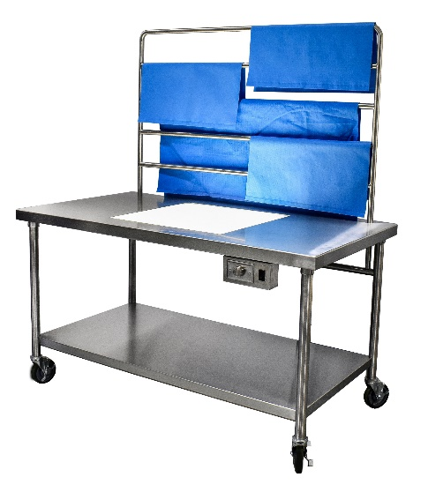
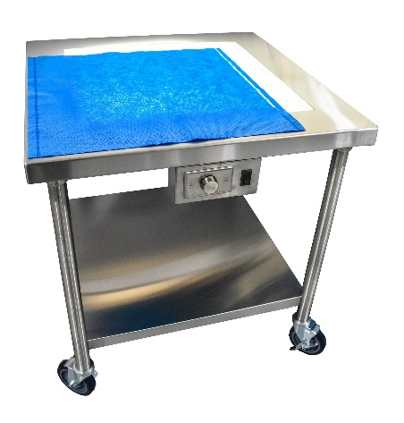
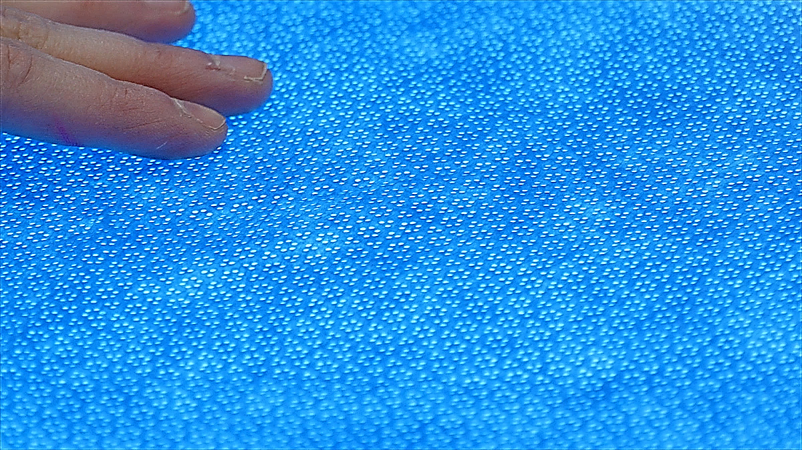
Lighted Assembly Tables
I should have a process in place to inspect blue wrap for tears/punctures/rips before I sterilize.
Mini or full-size assembly table options
PureSteel™ Mini Inspection Table
Lighted table enhances users’ ability to check for imperfections
Set-up all assembly tables with lights, or make dedicated wrap inspection stations
PureSteel™ Wrap Inspection Table
Notes:
The first insight, inspection of wrap, can help enable better QC and storage programs. If you have consistent issues w/wrap punctures or damage in sterile storage, do they arrive like that to sterile storage, or is it your racks?
To have an inspection method in place, make sure your wraps are of high quality, sound construction before the sterilizer, it can eliminate wasted time in improving one area of the department or another.
Also: Don’t need to invest in full renovation; mini-options are available for immediate inspection capabilities. Maybe you also need to fix wrap storage. Why not inspect wrap right after you pull off the shelf from storage? Lots of quick options.

Slide 9
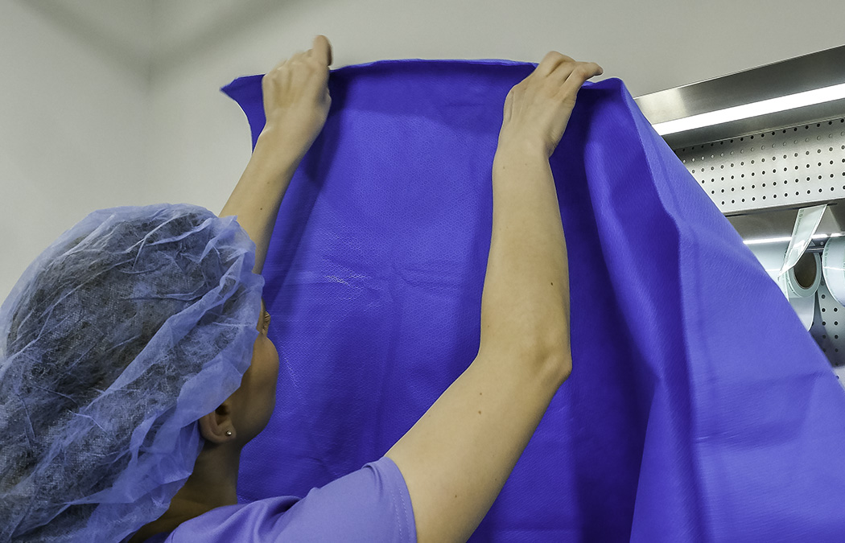
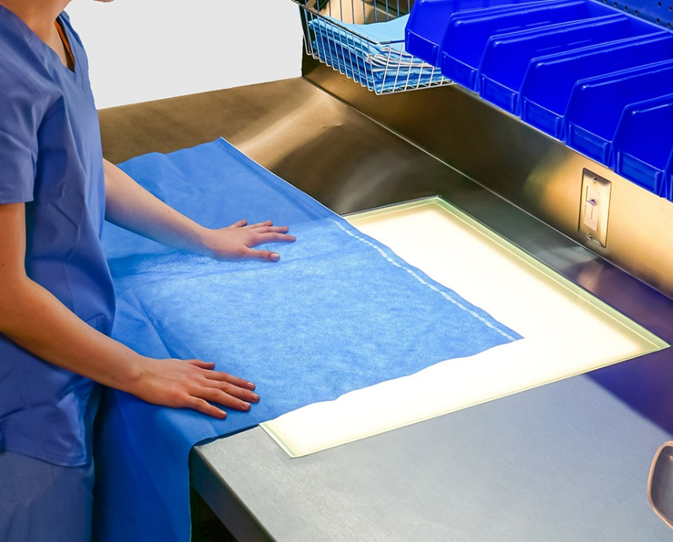
I should have a process in place to inspect blue wrap for tears/punctures/rips before I sterilize.
BEFORE
AFTER
Check out our CE Program on our vendor page on packaging material inspection.
Notes:
Ergonomically there are benefits too – holding up to the light, which let’s be honest doesn’t have the lumen brightness for thicker wraps anyway, can be hard with large wrap sizes. Strenuous activity in direct conflict with OSHA recommendations.
Wrap can drag on the floor, get dropped more easily, snagged… not a best practice.

Slide 10
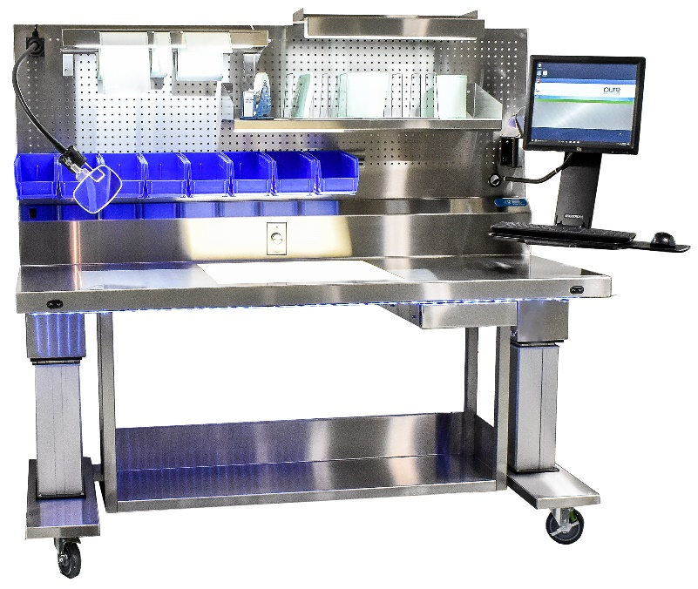
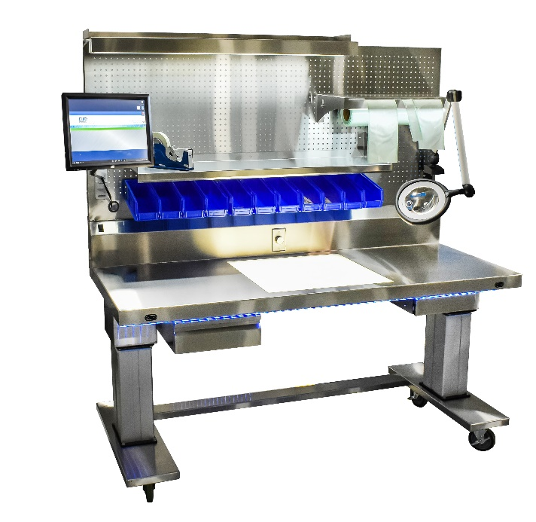
Lighted Assembly Tables
I’d like to make sure my assembly tables are organized and enhance worker efficiency.
PureSteel™ Ergonomic Workstations
Notes:
Organization another critical element with assembly tables. It can make or break the workflow in your department.
Organization might be something to consider now before your tables are inundated with wrapping & assembly.

Slide 11
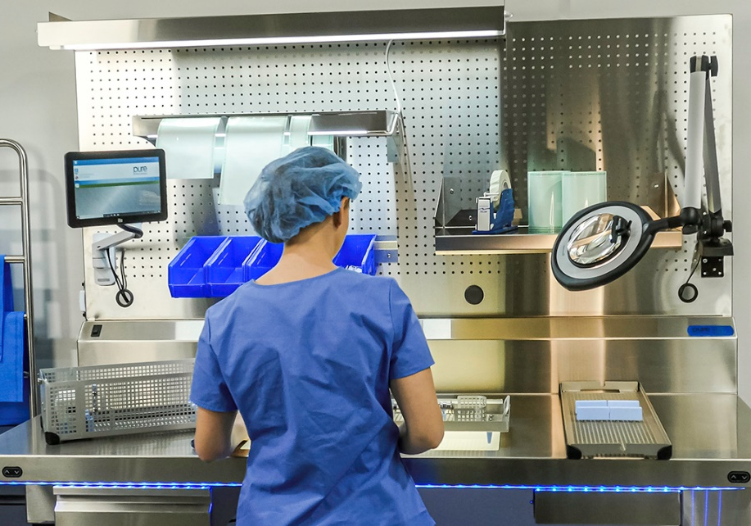
I’d like to make sure my assembly tables are organized and enhance worker efficiency.
Lost efficiency occurs when:
  Workers are wandering around to find pieces to assemble trays
  Equipment can’t be added because of missing outlets & power
  There’s no room to organize all steps in one place
PureSteel™ Ergonomic Workstations
Notes:
It’s clear how good organization supplements efficiency, so easier to evaluate the other way around.
Bad organization, tables left to get into a mess, results in:
Workers searching for missing items, wandering to assemble trays, maybe grab the wrong items…
Poor equipment management. Lots of powered equipment at tables. When it’s time to implement new computers/sealers/lights, do you have enough electrical? Do your tables include electrical? You can’t afford downtime to wait on electrical drops when you have new processes to add now.
No room to organize means the disorganization gets transferred elsewhere. Your 1 well organized station now can easily turn into a mess because another station was left to get messy.

Slide 12
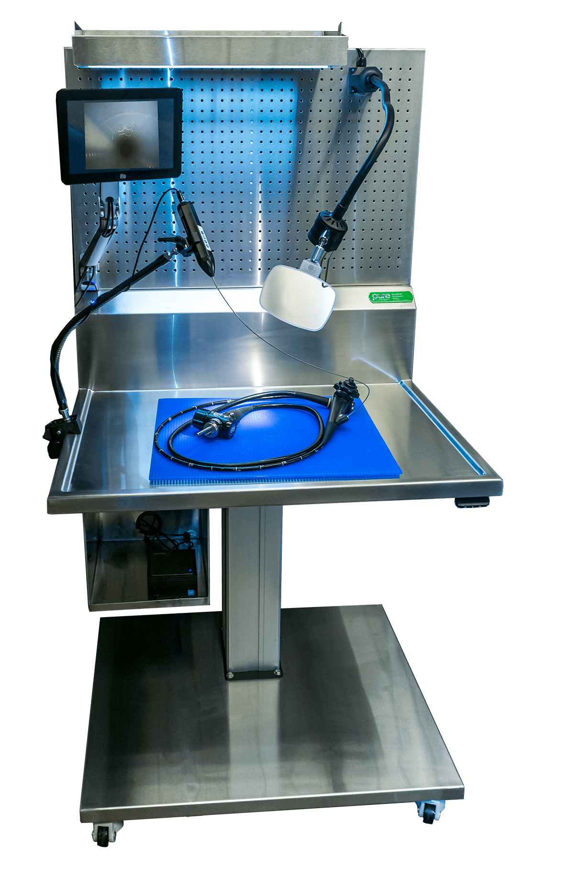
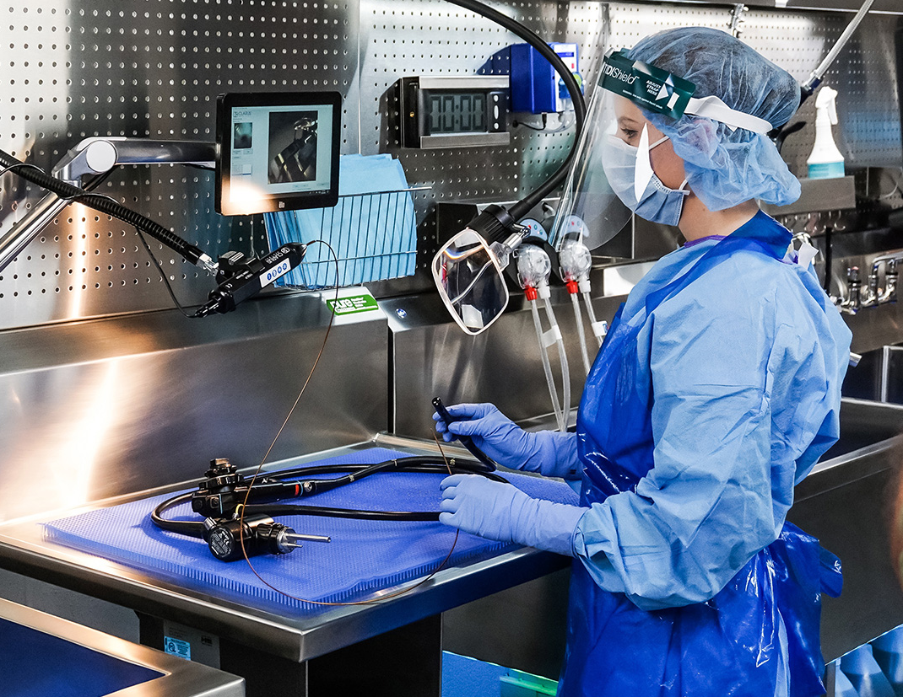
Borescopes
I should have a QC system in place to identify bioburden and instrument damage before instruments are sent to assembly.
PureClear™ Visualization Station & Borescopes
Notes:
Borescopes provide another avenue for instrument reprocessing staff to improve overall cleaning quality. With lumens, especially in scopes, it’s difficult to verify how clean are my scopes, really, with definitive data.
Borescopes provide the tool to gather data, and good data drives good plans, and good results.

Slide 13
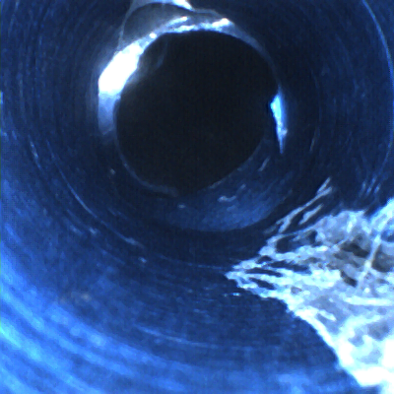
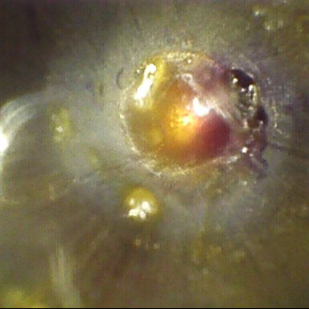
Borescopes
Residual fat in channel: Are my pre-cleaning processes efficient?
Possible instrument damage: is this cleanable?
12.4.2: “Tools such as video borescopes of an appropriate dimension (length and diameter) may be used to visually inspect the internal channels of some medical devices.”
ANSI/AAMI ST91:2017
Notes:
With borescopes, think about these 2 main areas to address: (1) bioburden, and (2) instrument damage.
Bioburden a little obvious, anyone would be looking for that, but when you do find it you can help more empowered about other QC initiatives you want to run. How well do we use or how good is our, enzymatic detergent? Is it appropriate for the types of bioburden we reprocess?
Are my cleaning brushes good, or poor quality? Do we flush well enough? Bioburden deposits can help guide that improvement plan.
Instrument damage can also be trigged by poor cleaning supplies, but beyond that, borescopes can also verify equipment repairs. Do repairs affect my internal lumens? Is it difficult to clean around repairs?
Borescopes enable you to more definitely answer those questions.

Slide 14
Stressor: Soaking
Meditation Insights:
(1) I can’t waste 30 minutes of time soaking robotics in sink basins and delaying other instrument reprocessing.
Sink basins are critical tools for reprocessing. How do we maximize their efficiency?
Notes:
Soaking is another place where department might get bottleneck, and your efficiency be stressed.
I focus on robotics here, but scopes, especially with delayed reprocessing presoaking requirements, can also become difficult.
We need to think of sinks as indispensable tools. If you had to give up just 1 basin, would you be worse off for it?
They’re hard to replicate; some requirements like DI rinsing, need to take place in a sink. Basins need to be prioritized. We can all probably think of how inefficient sink basins are, either in their size, depth, and how many might be available to us.

Slide 15
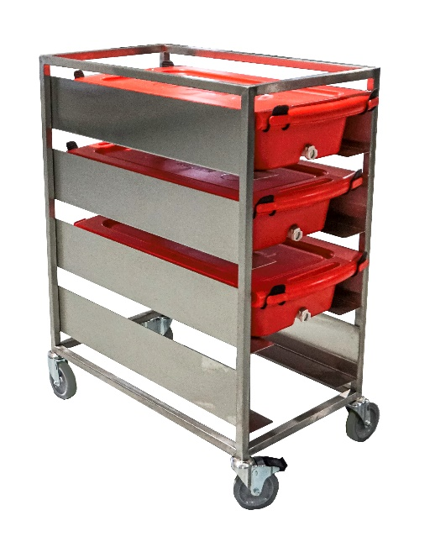
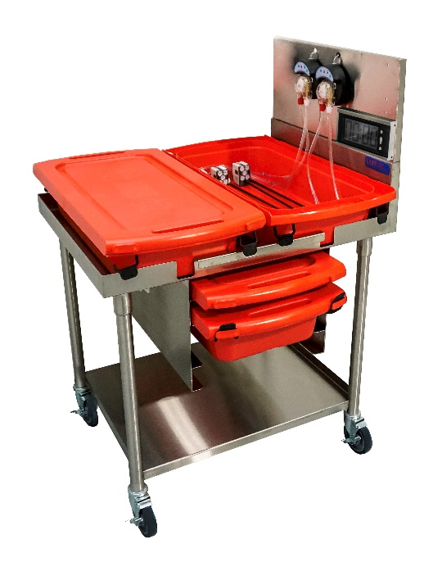
Robotic Soaking
Mobile carts make good soaking solutions:
  Free up sink basin space
  Vertical soaking
  Container storage
  Accessories?
PureSteel™ XL Tiered Cart
PureSteel™ XL Transport Cart
Notes:
Mobile carts are a good, quick fix for soaking troubles. I think they offer 3 main benefits:
Prioritize your sink basins for sink basin activities, those instruments and sets that need to be done in sinks. The mobility factor added in makes carts easier to wheel away when not in use.
Vertical storage takes up less of a footprint if you need carts. Consider stacked or tiered options.
If you prefer using containers without carts, but you have a lot of them, how do you store the containers? Sometimes carts make good storage for container systems when not in use
Question how accessories will be organized on carts, if they can. Explore options that might provide mounting for timers, dose pumps, enzymatics… common soaking accessories.

Slide 16
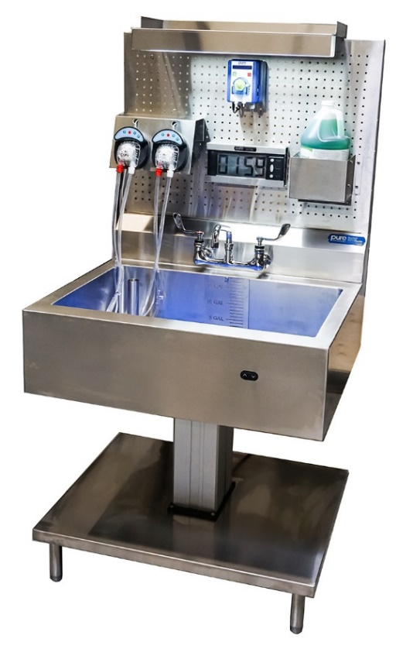
Robotic Soaking
When soaking needs to double as reprocessing, consider:
  Ergonomics
    Height-adjustability
    Wrist slants
  Accessory organization
  Electrical
PureSteel™ Xi Reprocessing Sinks
Notes:
In situations where you need the capacity that a hard-plumbed sink can provide, consider the following:
Is it ergonomically up to spec? Are my staff doing to have pain issues at the sink? How does my vendor consider ergonomics outside of just height-adjustability?
Accessories can take a good sink, turn it into a disaster. How do you mount those accessories? Can you organize their power cords?
Electrical, another place where sinks fall short. Are you given the capacity to add future equipment at the sink without waiting on power from facilities? Don’t let that delay you in future growth -

Slide 17
Stressor: Flushing
Meditation Insights:
(1) I need systems in place so all staff flush the same way, every time.
(2) Manually flushing lumens isn’t the efficient, standardized process I need for my IFU.
Notes:
Flushing is another place where we notice staff get bottlenecked.
Consistency and efficiency are hard to improve hand in hand sometimes.
But there are automated methods to help with lumen flushing that can improve both at the same time.

Slide 18
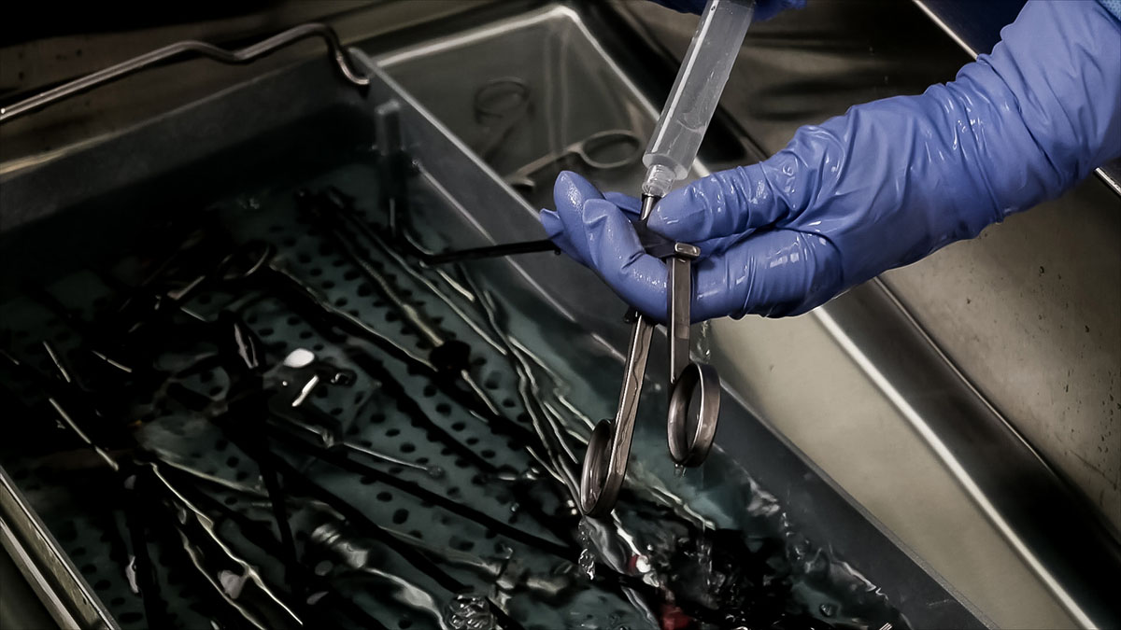
Lumen Flushing
I need systems in place so all staff flush the same way, every time.
Syringes are a hidden efficiency danger:
One lumen at a time
Painful
No one person flushes the same as the next
Efficient?
Notes:
Instruments become more & more complex in the modern SPD, but the way we flush continues to stay the same. Syringes and spray guns are inefficient methods that can’t keep up with the more complex IFU demands in SPD reprocessing.
Traditional methods of flushing, they’re:
- Slow, laborious
- Do one instrument/lumen at a time
- Syringes don’t fit all instruments..

Slide 19
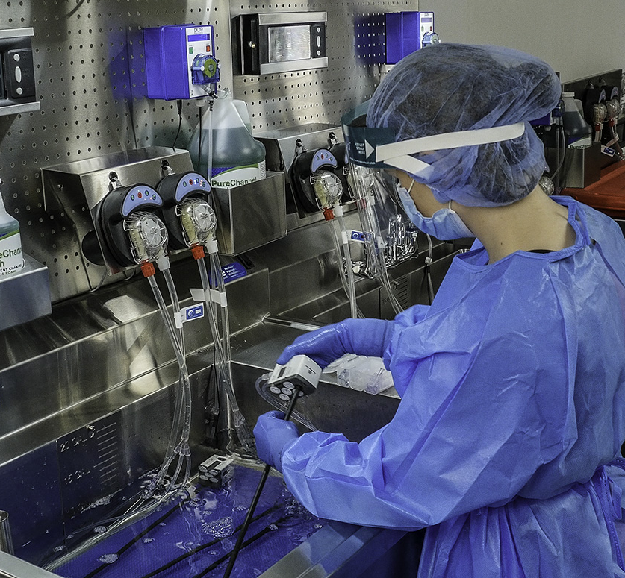

Automated Irrigators
Flush multiple instruments at once, increase throughput
Consistent pressure, speeds, volumes
Hands-free; reduce ergonomic pain
Watch our Royal Flush CE Program on our website for educational credit on lumen flushing.
19
FlexiPump™ Independent Flushing System
Notes:
Automated irrigators are 1 option to help increase efficiency here, that are readily available for SPD.
Our FlexiPump System, for example, can flush multiple instruments at once, so you can increase throughput. There’s flexibility to flush a variety of instruments, good for flexible scopes, ocular instruments, robotics, ortho, etc.
Everyone flushes the same way, every time with consistent volumes, speeds and pressures. Makes following your IFU a little easier.
Automated irrigators are also hands-free; hook up your lumens, flush… able to work on something else while the pump flushes. Great solution for relieving a stressed workflow at the sink.

Slide 20
Stressors: Ergonomics
Meditation Insights:
(1) Deep sink basins are causing my staff pain and discomfort.
(2) I need anti-fatigue mats that are durable and easy to clean.
Notes:
Ergonomics is the last “stressor” I’ll talk about today. While ergonomics is a big word, doesn’t have to mean big, renovation projects. Can include simple touch-ups and fixes to your current equipment.
Two common issues I see in reprocessing departments today: deep sinks, and poor anti-fatigue mats. Both issues have simple, quick fixes that can be long lasting, efficient ways to improve worker safety in the reprocessing department.

Slide 21
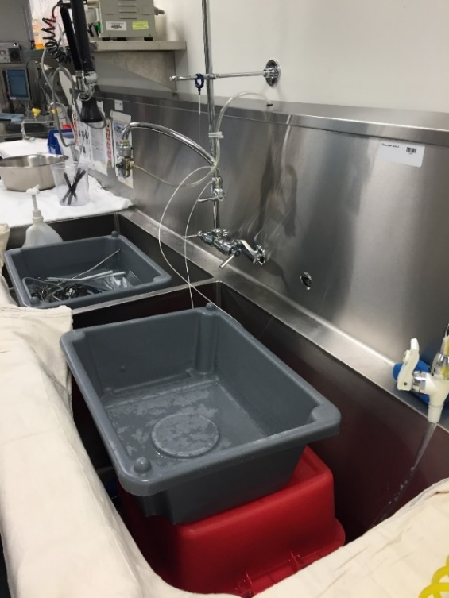
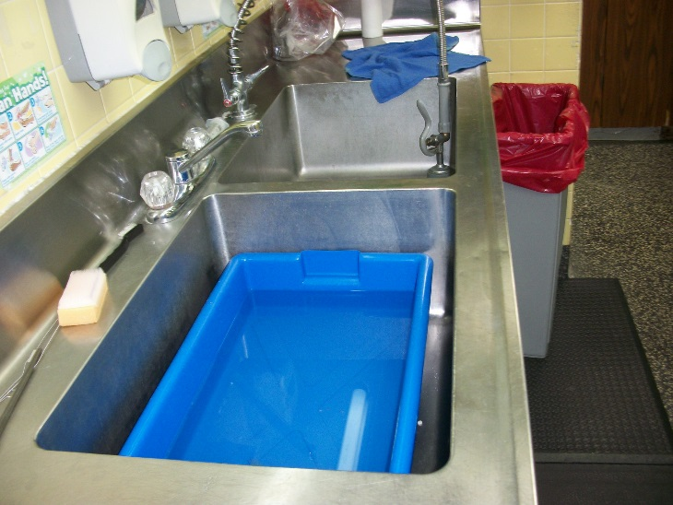
Deep Sink Basins
Deep sink basins are causing my staff pain and discomfort.
Notes:
Tell me if this is a department you’ve seen in SPD, GI…
Unnecessarily deep sinks are a bit of a double edged sword, they’re necessary sometimes, but most the time they cause back pain, high level of discomfort.
Height-adjustable sinks are a great way forward, but they don’t change the basin depth. Even HA sinks may need more work to make them even more ideal.
These makeshift basins don’t do enough: hard to drain, how do they help you use your enzymatics?
But this doesn’t have to be the reality.

Slide 22
Sink Inserts
Fit majority of sink sizes, even custom
Cart washer safe
Features for enzymatic maintenance: thermometer strips, dilution well, overflow handles
Great for ocular reprocessing; scope leak testing
PureStation™ Sink Inserts
Notes:
Sink inserts do exist for these sinks. They:
Fit the vast majority of sinks, even custom. Drop it in to raise the working level. No install, so when 1 person doesn’t need it, take it out and store it.
Cart washer safe construction makes it easier to clean
Built-in accessories make maintaining enzymatics chemistry easier. Am I within temperature range? Did I dilute properly?
Inserts are great for ocular reprocessing, scope reprocessing. Separate out your ocular reprocessing, get inserts w/built-in lights for enhanced leak testing.

Slide 23
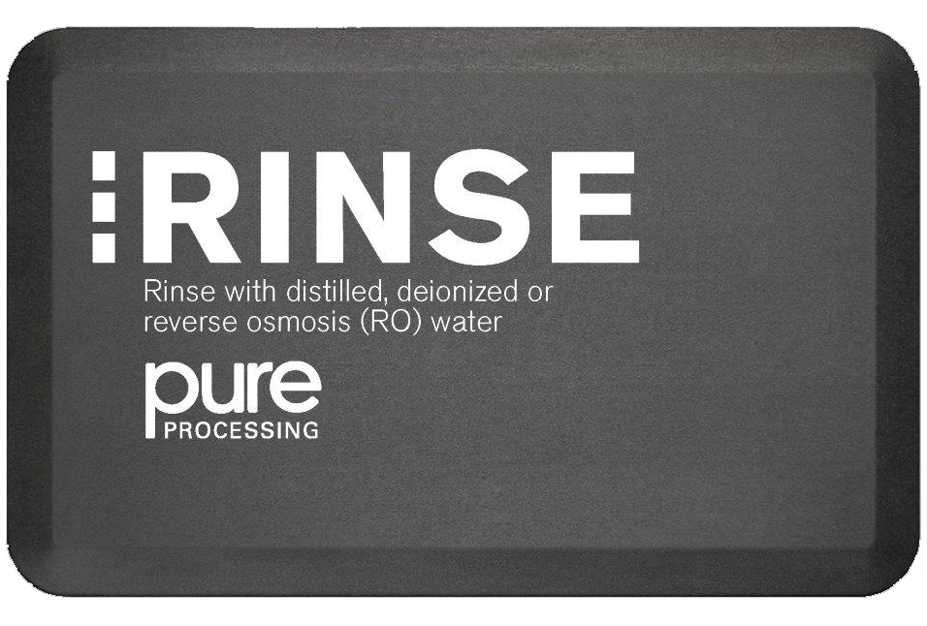
EcoPro® Workflow Anti-Fatigue Mats
I need anti-fatigue mats that are durable and easy to clean.
Cart washer safe
Great comfort for variety of people & needs
Good in decontamination & assembly
Training tool around workflow
Notes:
Quick note on mats: Mats in reprocessing rooms, specially decontam, should be:
- Easy to clean. Perforated mats can be difficult to clean with just mopping or sprays. How durable are they to certain methods of cleaning?
Standardize in assembly, break rooms, locker rooms, decontam… if possible. Makes replacing/swapping easier.
Can mats be a training tool? Absolutely – one example are workflow mats. Put something in front of each basin to indicate what task happens at each basin. Make it foolproof; set reminders. Make it easy for new staff…

Slide 24
Homework
Take moments every day to stop, and consciously mediate on what needs addressing before electives resume
Utilize resources from IAHCSMM, local chapters
  Online Buyer’s Guide
Check with vendors: virtual in-services available?
Cross-train; utilitarian players might be necessary
Notes:
So I do have some homework for everybody, but hopefully these are helpful assignments.
(1) Try as you might to take some time for deep thinking every day. Meditate on what issues you’re facing, how deep do those issues run? If it’s a big project, can I break it down and make the improvements more bite-sized? Helpful step before action planning.
(2) Utilize the resources from IAHCSMM, your local chapters if you have access to one. I love the Online Buyer’s Guide at IAHCSMM’s website for when you need to evaluate product changes,
(3) Check with your vendors: how are they providing resources to you right now? Are they offering services virtually? Are they offering CE programs?
(4) Take the moment to cross-train you or your coworkers. Utilitarian players may be a necessity, and it makes your team more flexible to unforeseen changes.

Slide 25


Personal Marathons
We’re all running through a marathon, hard to say how far along the path we are.
Like Rhonda, a moment to breath, think, can help guide our decisions.
Marathons make us stronger, smarter. Excited to meet the CS world that crosses the finish line.
Notes:
As a quick wrap-up, we all feel like we’re running our own personal marathon right now, hard to tell how far along the path we really are.
Like Rhonda, if we take a concerted effort to stop, think, breathe, and mediate on the potential issues around the corner, we can plan out our run plan through this marathon in a more efficient way, and hep make good decisions.
In the end though, marathons make us stronger, smarter. Rhonda has since been running for the Davis Phinney foundation; her personal marathon now helps improve the lives of others, just like the way CS roles support the rest of the hospital.
Excited to meet the CS world that crosses the finish line, and all the things we’ll learn from each other and improve on in the meantime!

Slide 26
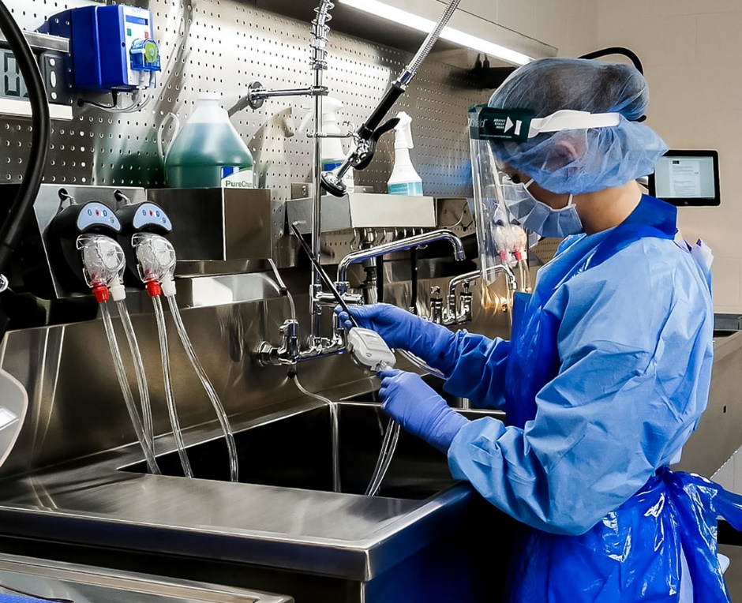
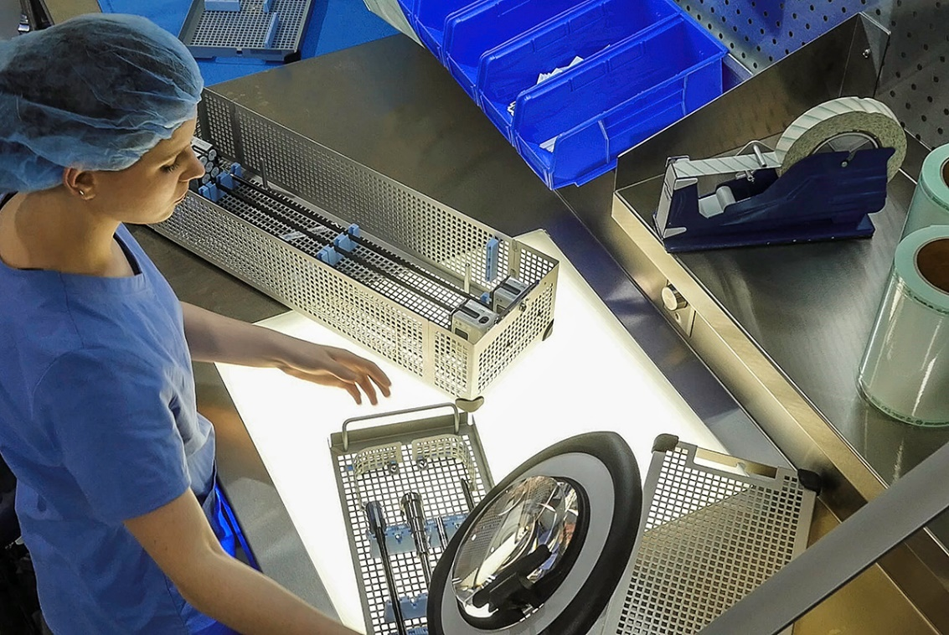
Questions?

